Slide 1
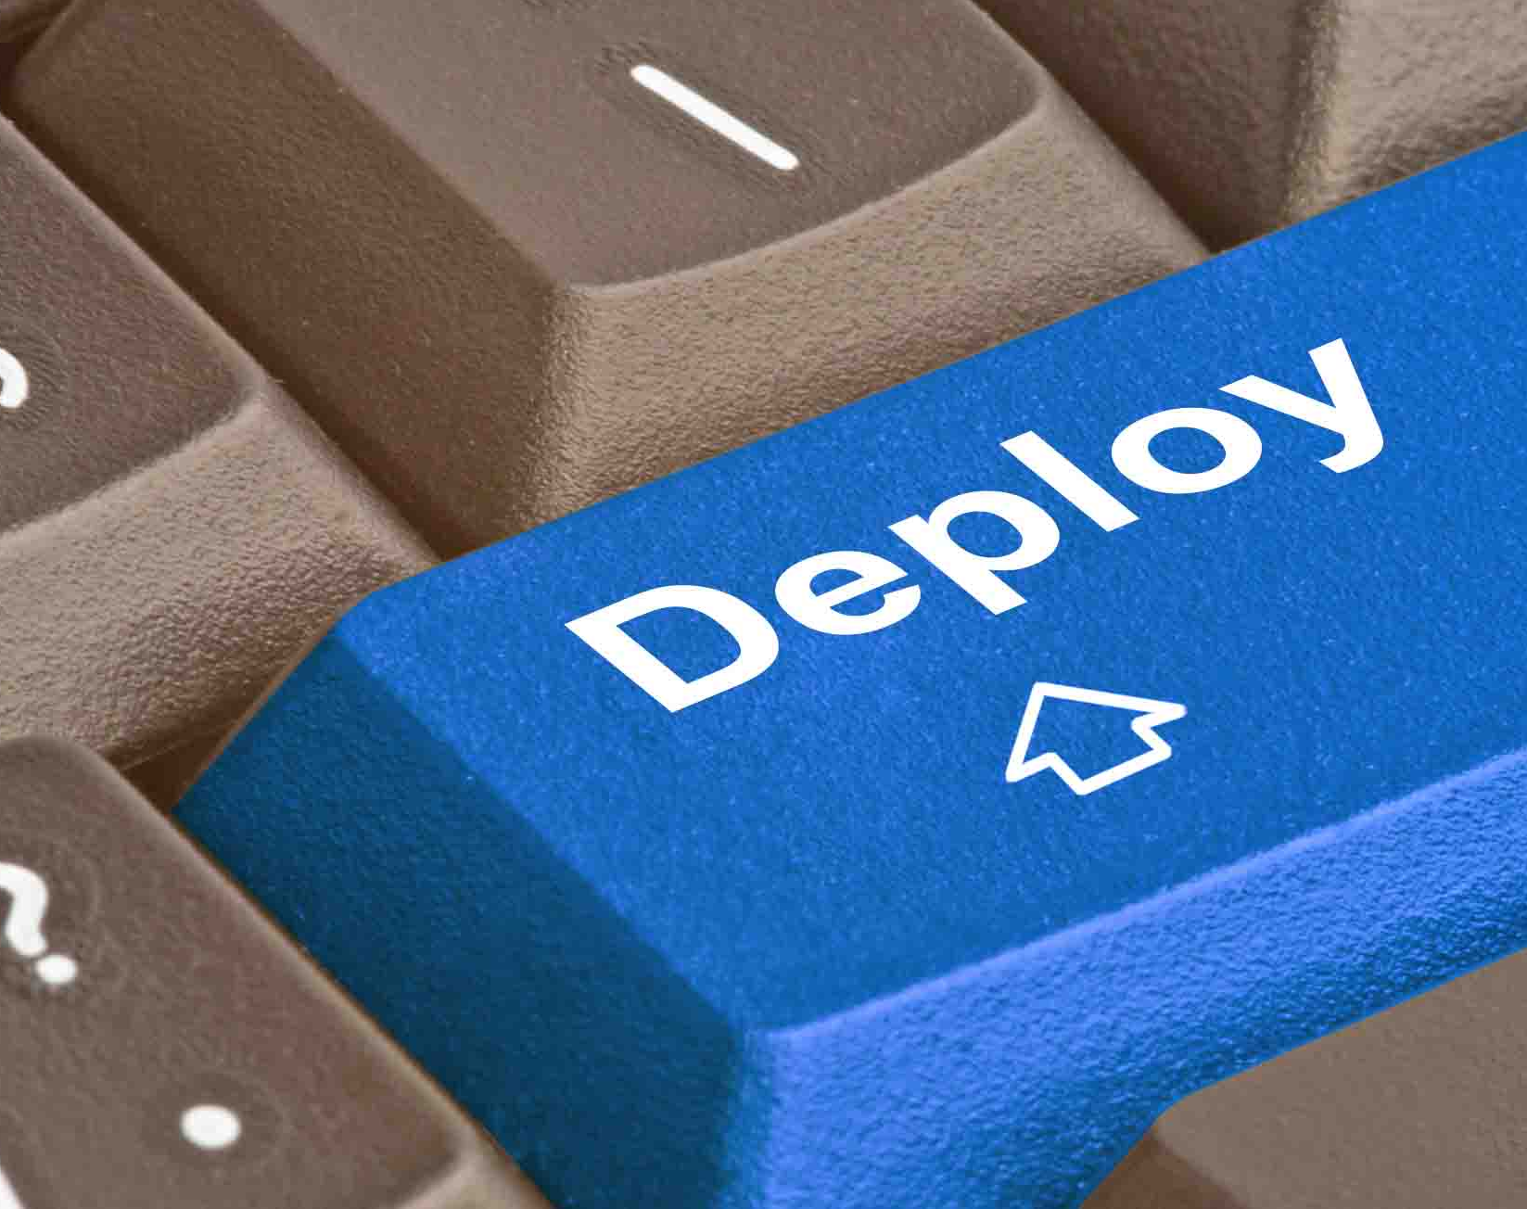
Deployments in a nutshell
Notes:
Should make a list of which services fit into which category for pipelines

Slide 2
How hard are they really?
Most deployments are very easy nowadays
Mostly a matter of knowing which deployment lives where and what buttons to press
A few require additional steps
Most pipeline issues occur when the pipeline is new since pipelines and environments rarely change

Slide 3
A brief history
RQ was originally built using TFS and deployed manually by Server Admins
As we gained more services, we started using TeamCity for deployments
A rare few apps deployed using Jenkins (Mostly Mac programs)
Azure Devops eventually phased out most TeamCity pipelines
Nowadays we almost exclusively use Azure Devops deployments

Slide 4
So what do we use now?
Most of our deployments are through Azure Devops
Some parts require manually running scripts or commands and recommitting the results to github
Some Kubernetes apps require updating the version number explicitly in the helm charts in github

Slide 5
Terminology
Artifact: A software package that can be easily shared and downloaded
Blue/Green Deployment: When we deploy a new version of a service to a new instance and confirm it works before swapping traffic over to it
Staging Slot: An instance of a service that we deploy a new version to and swap to serve traffic
Instance: A version of a service that is running.

Slide 6
General Deployment flow: Builds
Download the appropriate commit of the solution we want to deploy to the build agent
Apply appropriate config transformations (at this point usually just version number)
Build the solution
Run tests
Archive the binary files and upload it to artifact storage
These artifacts are usually stored for about 30 days

Slide 7
General Deployment flow: Deploying
Download appropriate artifact and decompress it
Apply environment specific configuration transformations
Upload files to destination
Start service, confirm new version is running
Swap current version to new version
A lot of our deploys also combine build/deploy into one pipeline

Slide 8
There’s always another secret
Secret data includes connection strings, tokens, credentials and more
Each environment has their own set of secrets
Source of truth is almost always Azure Keyvault
During the deployment process, these secrets are usually pulled down by Azure Devops and copied to the configuration file
For K8s, secrets are often stored in Docker Secrets
Sometimes rarely we’ll store secrets in the Azure Devops pipeline Variable page.
Variables can also be overridden from the Azure Web App’s Config section

Slide 9
RQ Deployments
RQ lives in 4 environments: Dev, Test, RC and Prod
Majority of deployments are automated
Prod deployments are handled by SRE
In the event of a hotfix we can follow the instructions here: https://wiki2.iqmetrix.com/display/RQMD/Building+and+Deploying+only+the+RQ+Client

Slide 10
RQ Database Deployments
Like RQ, nearly entirely automated
We sometimes need to deploy integration schema changes
Normally we don’t need to worry about RQ DB deployments, but on rare occasions a deploy will fail and we’ll need to run a deployment manually
These instructions are in the RQ.Database build pipeline, but you can also find them here: https://bit.ly/2M0eMFo
Once you fix the issues you can requeue up an RQ.Database build.
This won’t update existing databases, but it should push the changes during the next day’s deployment.
Databases we test with should be updated daily. You can update databases yourself manually with the db script creator tool. Client database updates are out of our hands.

Slide 11
Azure Devops Pipelines: Two different types
Tasks
Easy for anyone to use; drag and drop WYSIWYG
Variables, tasks, variable groups etc. all easy to change and edit
YAML based
More difficult to more flexible
Can utilize templates
Tighter control over config changes
GIT based history
Notes:
https://github.com/iQmetrix/RQ.DevOps.Pipelines/blob/master/blueGreenKubernetesBuildAndDeploymentPipeline.yaml
https://dev.azure.com/iqmetrix/Azure%20DevOps%20Documentation/_wiki/wikis/Azure-DevOps-Documentation.wiki/230/RQ-DevOps-Pipeline-Guide
Task based: https://dev.azure.com/iqmetrix/RQ/_apps/hub/ms.vss-ciworkflow.build-ci-hub?_a=edit-build-definition&id=1537
YAML based: https://dev.azure.com/iqmetrix/RQ/_apps/hub/ms.vss-build-web.ci-designer-hub?pipelineId=1420&nonce=imvbMc/JHx7Jji3w66Rz5g%3D%3D&branch=master

Slide 12
What about Teamcity and Ruby buildscripts?
What about them?

Slide 13
Standard K8s Deployment
Done entirely through one screen
We can deploy to an environment, roll back to previous version or remove the previous helm release
Can usually only deploy something committed to master; no branches. You won’t be able to deploy if a build is a feature branch.
To deploy to current environment, it must have been deployed to previous environment and requires someone to approve
Notes:
https://dev.azure.com/iqmetrix/RQ/_build/results?buildId=400784&view=results
https://dev.azure.com/iqmetrix/RQ/_build/results?buildId=426477&view=results
Look up: what does “remove previous helm release” mean?

Slide 14
Web in RQ/Hub apps
Done entirely through Azure DevOps Pipelines
Can deploy to any environment from this page
Can only deploy new versions, no rollback capabilities unless you find and redeploy an old version
Requires approval and previous environment deployment success to deploy to next environment
Hub V1 and V2 are deployed through Teamcity
Notes:
https://dev.azure.com/iqmetrix/RQ/_build/results?buildId=371321&view=results
https://teamcity.iqmetrix.com/project.html?projectId=HUB
https://teamcity.iqmetrix.com/project.html?projectId=HubV2

Slide 15
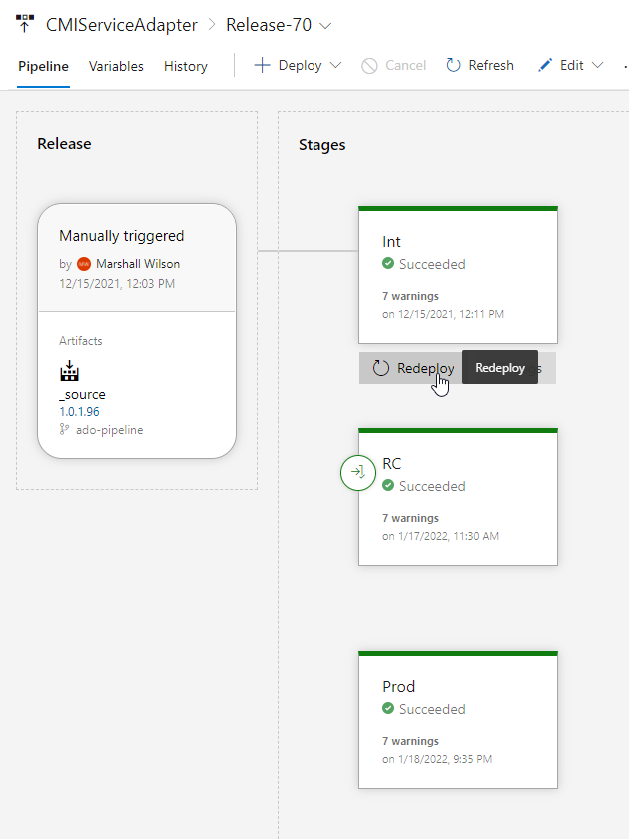
CMI Deployment
Pipelines handled in Azure Pipelines; Any build artifacts will be created by the CMI Deployment PR pipeline
Deployments themselves are handled by Azure DevOps Releases
We can easily deploy any artifact to any environment using the UI
Notes:
https://dev.azure.com/iqmetrix/RQ/_releaseProgress?_a=release-pipeline-progress&releaseId=34884

Slide 16

Vendor Inventory
Our only set of services with a dedicated page on deployment
Requires pushing out Integrations DB Schema to clients, building and deploying VERDIS and VIS K8s apps, VIS functions and possibly VIS RMA app.
A lot of this is automatic, but there are some manual pieces to be aware of
Notes:
https://wiki2.iqmetrix.com/display/IN/VIS+Ecosystem+Deploy

Slide 17
Deploy VERDIS
Create a new version using a git tag
Kick off a build manually using this specific version in Azure Devops
Update the YAML file in either the k8s.development or k8s.production repositories on github to use this new version

Slide 18
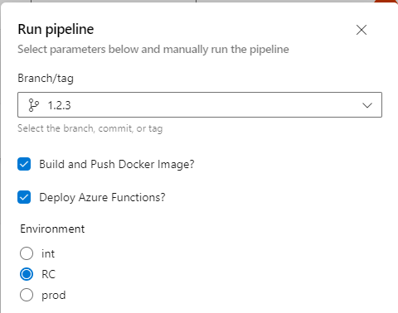
Deploy VIS
Create a new version using a git tag
Kick off a new build using this specific tag
Make sure to push the docker image and to publish the function
Update either k8s.development or k8s.production github repos with this new version

Slide 19
Integrations Scripts
Grabs all integrations changes from RQ.Databases
Creates a script to modify a database with the changes made
Running this script in a specific environment will update all client databases with the integrations changes

Slide 20
RQ Bridge Scripts
Integrations Schema location: https://github.com/iQmetrix/RQ.Database.IntegrationsSchema
Run \RQ.Database.IntegrationsSchema/deploy/RunBridgeScriptAgainstClientDatabases\create-integrations-deploy-script.ps1 and save the resulting script over the existing script
PR the changes, get them reviewed and merge them in
Queue a new build in https://dev.azure.com/iqmetrix/RQ/_releaseProgress?_a=release-pipeline-progress&releaseId=33981
Notes:
https://github.com/iQmetrix/RQ.Database.IntegrationsSchema
https://dev.azure.com/iqmetrix/RQ/_releaseProgress?_a=release-pipeline-progress&releaseId=33981

Slide 21
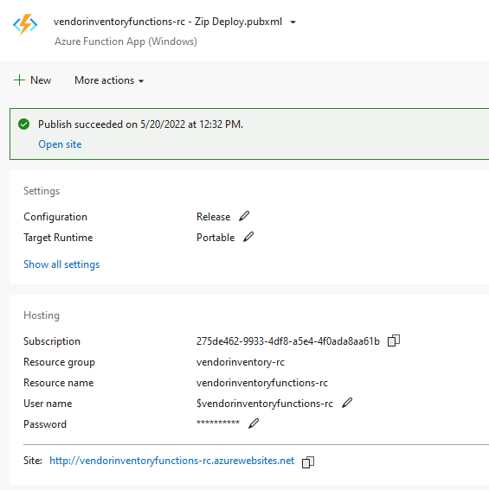
Manual Azure Webapp Deploys
Only used if we have no other choice
Done through Visual Studio
May need to manually make config changes
Specify resource group, resource name, enter credentials and run
Deploying K8s manually is much more complicated
Notes:
Run demo in Visual Studio: deploy vendor inventory functions

Slide 22
Troubleshooting tools and techniques
Deployment log files
Azure webapps: Kudu
Kubernetes: Dashboard
Fellow Inventory Team members
SRE Team (Platform Operations)
Dan Schroeder (panic button)
Notes:
https://cmiadapter-prod-westus1.scm.azurewebsites.net/
https://dashboard.azure.development.k8s.iqmetrix.net/

Slide 23

This is how we often used to do it…

